Slide 1
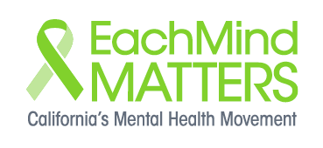
Each Mind Matters
Webinar Series
Building Resiliency: Self-Care
Notes:
Aubrey

Slide 2
Welcome!
If you have a question, technical problem or comment, please type it into the “Questions” box or “raise your hand” by clicking the hand logo on your control panel.
Notes:
Aubrey
We will be recording this webinar. If you have a question, technical problem or comment, please type it into the “Questions” box or “raise your hand” by clicking the hand logo on your control panel. We will answer the questions at the end of the presentation and follow up with you individually by email if your question is specific.

Slide 3
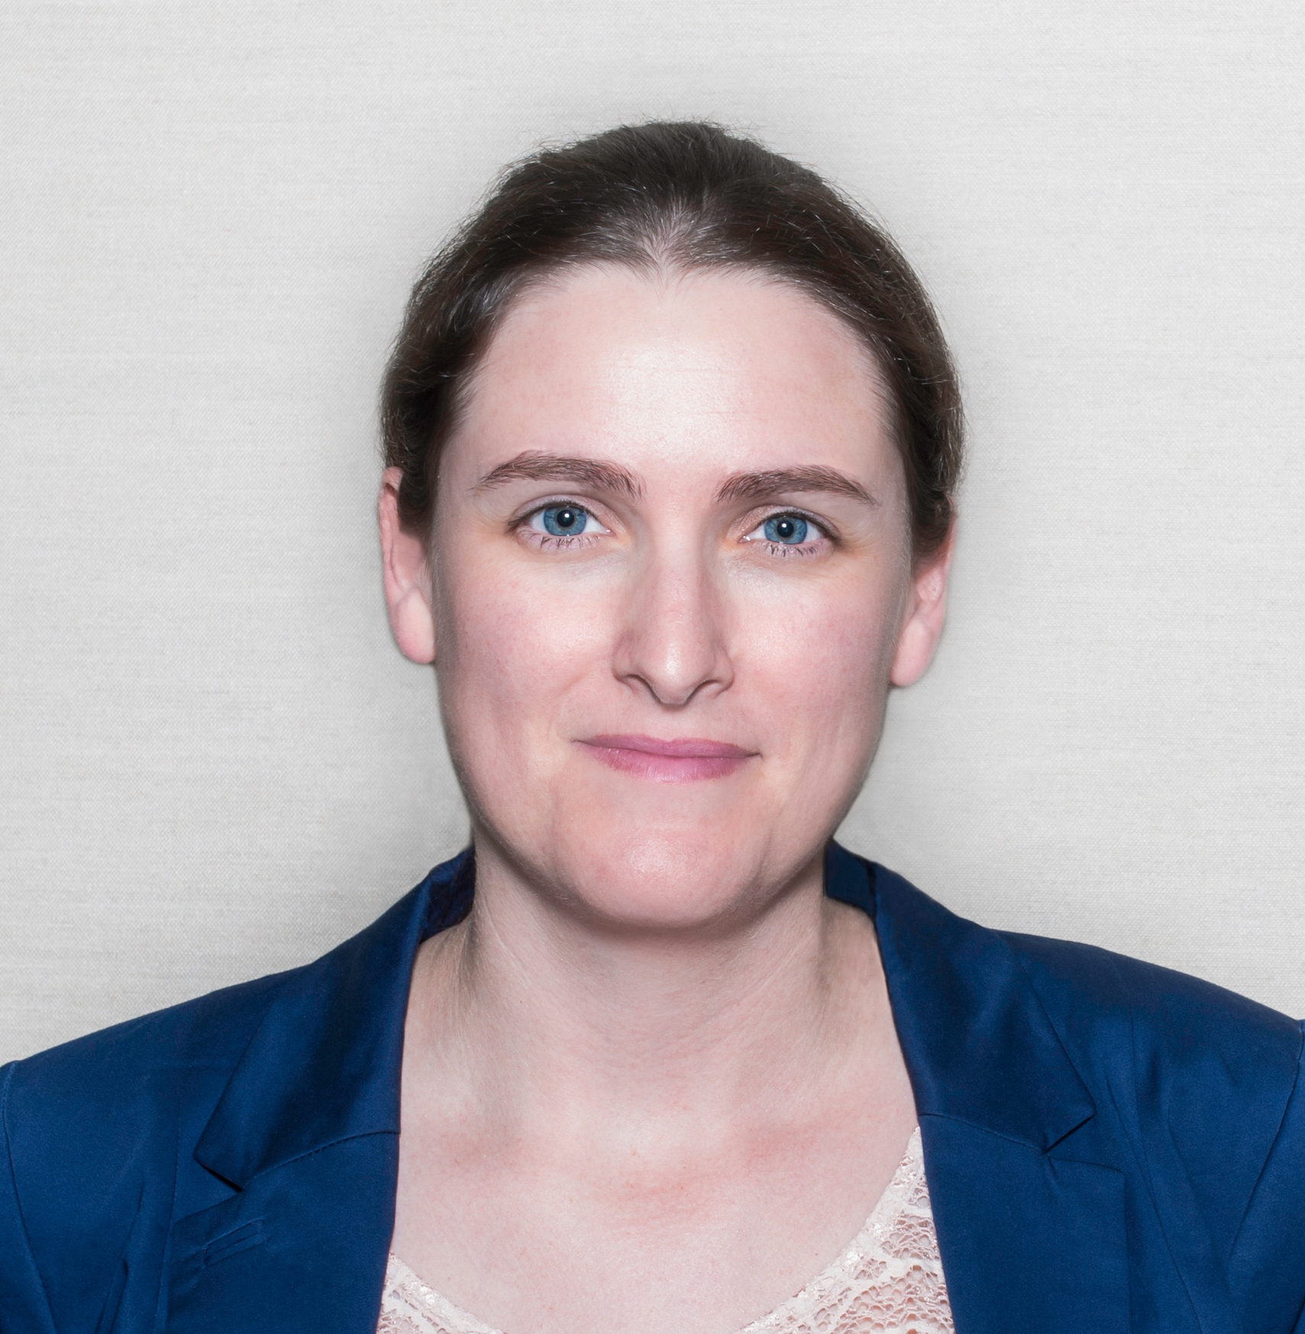
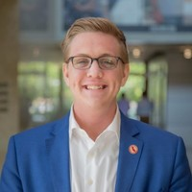
Introductions
Aubrey Lara
Sacramento, CA
Ryan Brown
Sacramento, CA
Lisa Smusz
Alameda, CA
3
Notes:
Lisa

Slide 4
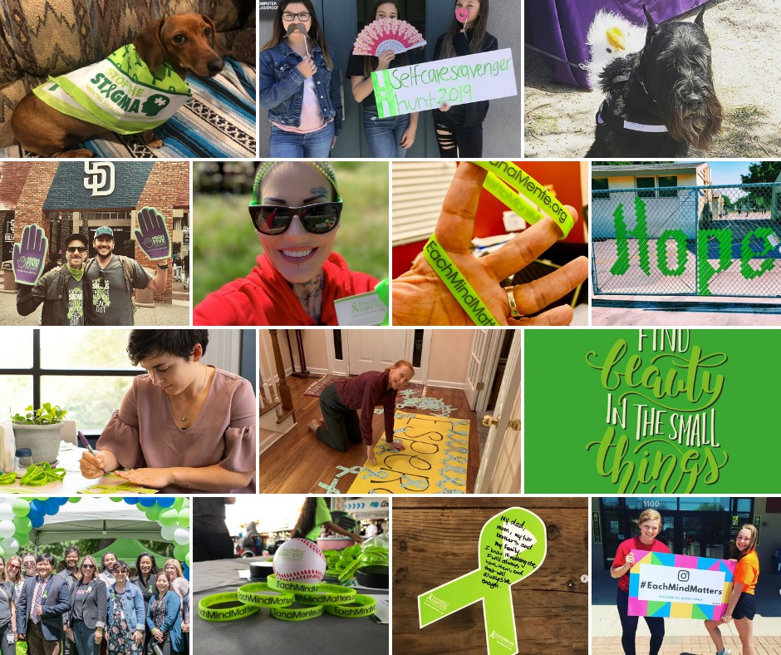
Provide an overview of how traumatic events impact individual and community mental health
Discuss what self-care is and why it’s important to prioritize
Share self-care strategies for ourselves and others
Review the new Self-Care Resources from Each Mind Matters and other resources
Today’s Objectives
Notes:
Lisa

Slide 5
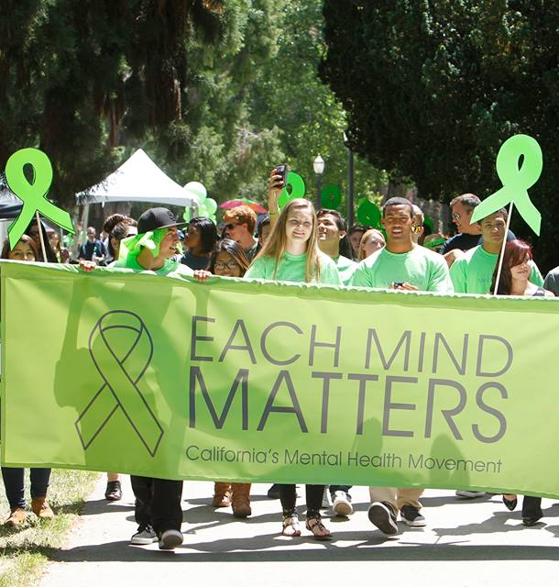
Each Mind Matters
Each Mind Matters is California’s Mental Health Movement. We are millions of individuals and thousands of organizations working to advance mental health.
Notes:
Lisa
Each Mind Matters is California's Mental Health Movement . We are all a part of this movement which serves as the megaphone to amplify the voices of individuals and organizations and highlight all of our collective efforts to promote mental health, end stigma related to mental illness and prevent suicide. We are a community of individuals and organizations dedicated to a shared vision of mental wellness and equality, starting in California. Wellness doesn’t mean we’ll never need help. It means we are resilient and focused on recovery. We believe in healing through action, the power of collaboration and the strength of diversity.
We all want to enjoy good mental and physical health, but sometimes we need some help. Our goal is to keep people healthy, act when mental health challenges arise, and provide the treatment, services, and help necessary to prevent any prolonged and unnecessary suffering.
Each Mind Matters is part of statewide efforts that are funded by counties through the Mental Health Services Act and administered by the California Mental Health Services Authority.

Slide 6
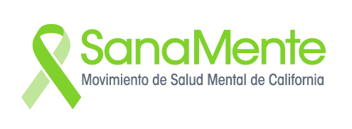
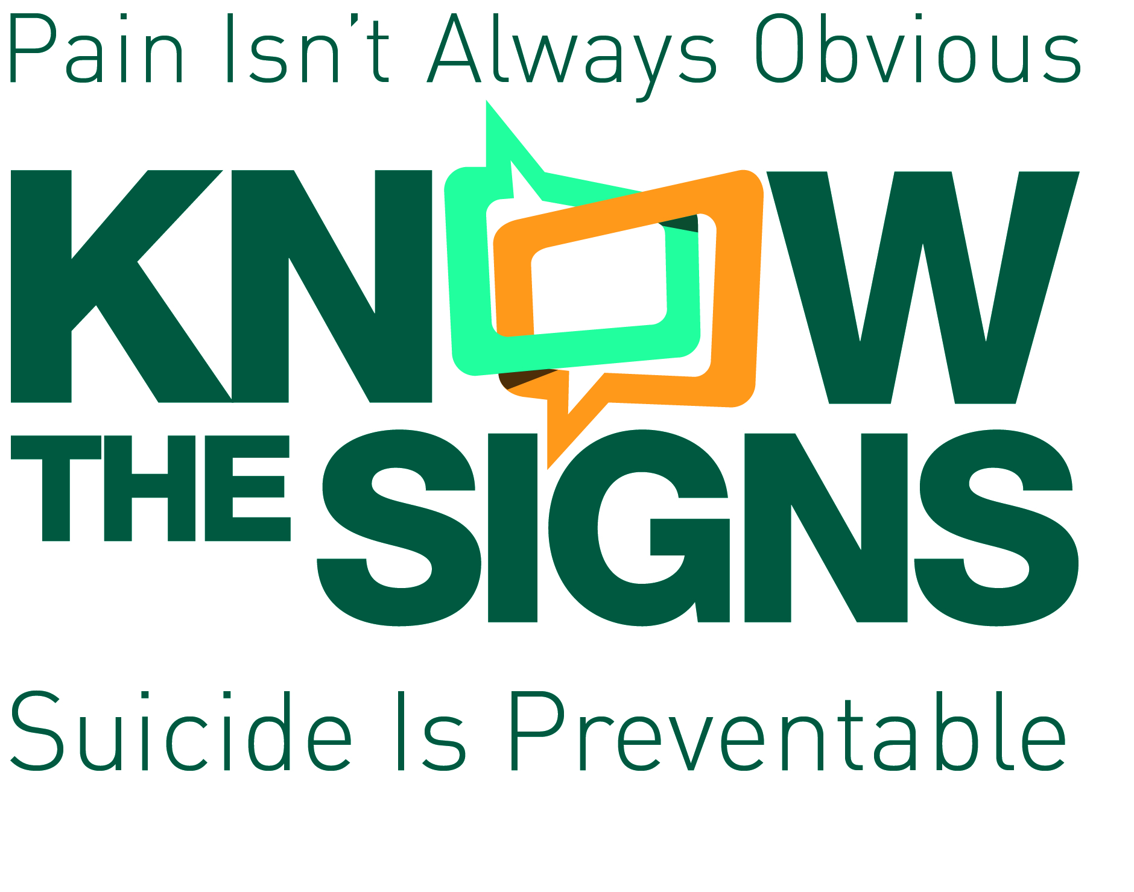
Our Initiatives
Learn more at www.EachMindMatters.org
Notes:
Lisa
SanaMente is the Spanish adaptation of California’s Mental Health Movement. Know The Signs and Reconozca Las Senales are our suicide prevention initiatives. Walk in our Shoes and Ponte en mis Zapatos are our mental health education and stigma reduction programs targeting youth ages 9-13.

Slide 7
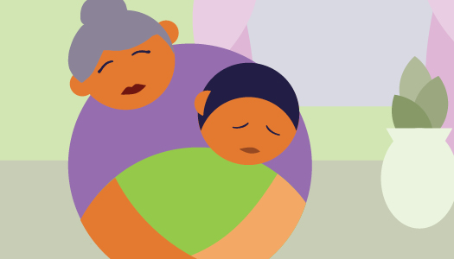
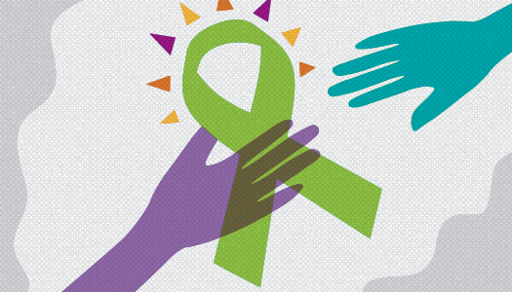
Impact Of Traumatic Events On Individual And Community Mental Health
Trauma can have lasting effects and can impact individuals, families, and whole communities.
What can we do about it? Build resilience through better individual and community self-care.
Notes:
Lisa
Trauma can have lasting effects not only on the individual in the moment, but on their families and whole communities: showing up as physical health problems, a shorter lifespan, or mental health problems sometimes years after the event.
According to the CDC, in 2016 alcohol abuse was linked to 88,000 deaths; more deaths than guns, opioids, or even HIV/AIDS at its peak. Drug-related deaths were at 63,500 (two-thirds of these involved opioids). And, almost 45,000 suicides were recorded. Increases in these types of deaths (sometimes called “diseases of despair”) are contributing to declining life expectancy in the U.S.
The odds are you or someone you know has been affected by those experiences. Which leads us to another question: What can we do about it? The short answer is: build resilience through better individual and community self-care.

Slide 8
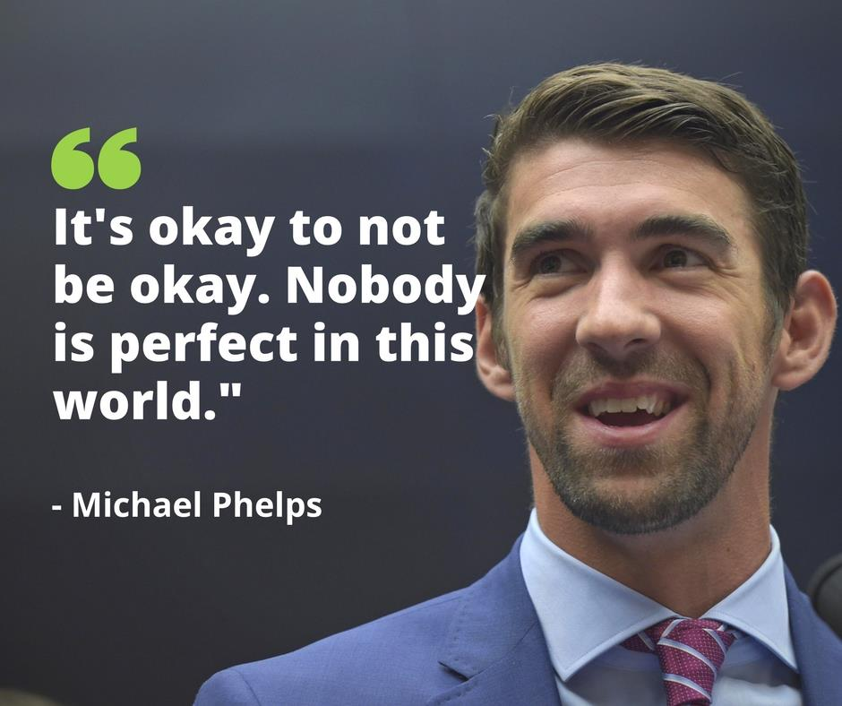
Why Is It Hard To Prioritize Self-Care?
Notes:
Lisa
Many of us on this webinar are mental health providers of one type or another. If you’re a licensed mental health provider you probably already know that every professional association’s ethical code has a statement that requires counselors to monitor their personal well-being while treating clients. This is because it’s imperative that counselors, or any one that cares for others, care for themselves first in order to be at their best and provide the best care. But this is easier said than done.
It’s easy to neglect taking care of ourselves when we’re busy and overwhelmed. Taking time to eat lunch, exercise, and hang out with friends? That can sometimes feel like a distraction from the “important” things you need to do, but ironically it’s when you’re busy and overwhelmed that you need self-care most.
We sometimes think about self-care as a reward for when you get everything done. You’ll take a nap when you finish that paper, you’ll work out after the work week: But in actuality self care prevents burnout, reduces the negative effects of stress, and helps you refocus. Self-care isn’t a reward for getting everything done -- it is a critical part of the process of getting everything done.
Similarly, practicing self-care may be tough for the people we work with to prioritize when they’ve experienced severe pain and trauma and learning self-care techniques may not feel important when they are looking for more drastic changes rather than day-to-day improvements.
It’s important that we as people in the mental health field model self-care as a part of building resilience, so that we -- and the communities we work with -- can more readily “bounce back” after difficult experiences or better heal from trauma.

Slide 9
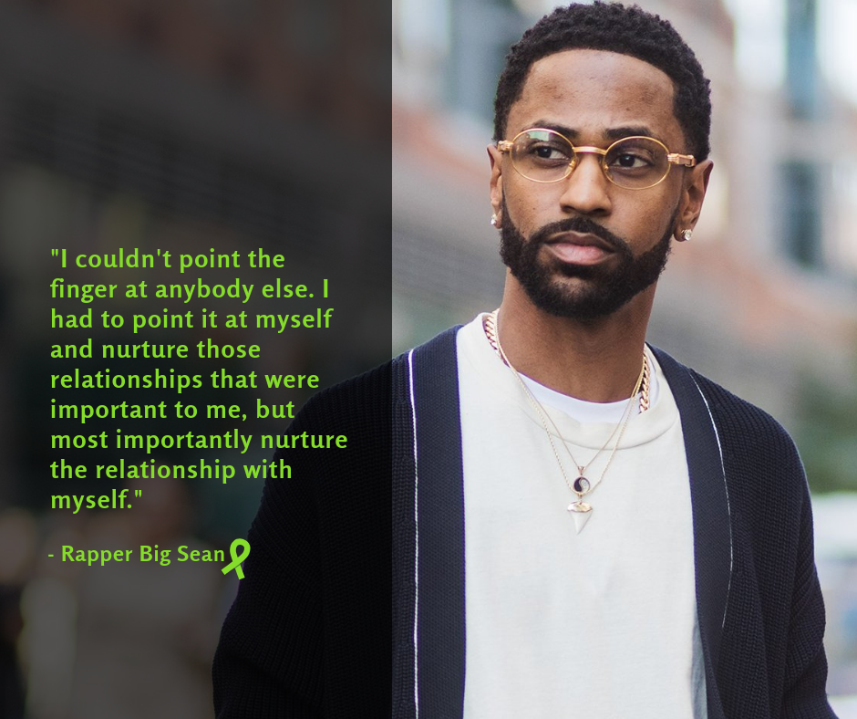
What Does Self-Care Actually Mean?
Notes:
Lisa
Real self-care -- the kind the builds habits that lead to a life you don’t need to escape from -- doesn’t have to be complicated. In general, a self-care plan falls into three domains: Physical, mental/emotional health, and spiritual health.
Everyone’s plan will look different -- if you’re a student with lots of mentally stimulating activities you might need to add more physical health items like taking a nap to your plan, whereas if you’re a counselor working with people who have experienced trauma you may need more emotional health wellness support to avoid burnout or vicarious trauma.

Slide 10
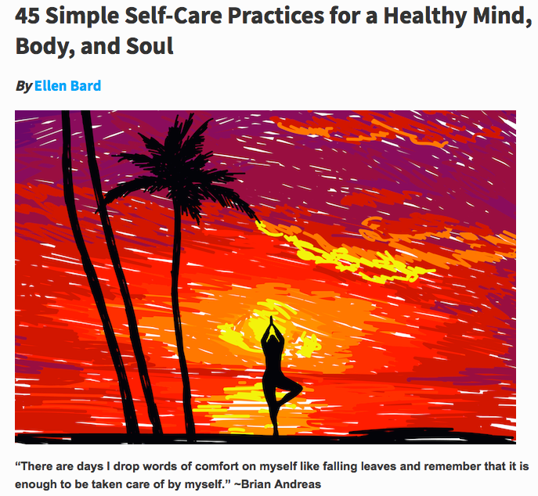
Self-Care Practices
Notes:
Lisa
Start your plan by thinking about just one thing you could add to your life each day. Get inspiration by looking at a list of simple self-care tasks, for example this list was taken from: “45 Simple Self Care practices for a healthy body, mind, and soul.” The website will be provided in the resources.
Physical health:
Research has proven that getting 20 minutes of sunlight each day can improve mood.
Physical movement, practiced regularly even for short periods of time, can improve mental health at the same level as antidepressants.
Mental and Emotional health:
Unplug for an hour. Switch everything to airplane mode and free yourself from the constant barrage of social media and email.
Write out your thoughts. Go for fifteen minutes on anything bothering you. Then let it go as you burn or bin the paper.
Spiritual health:
Help someone. Carry a bag, open a door, or pick up an extra carton of milk for a neighbor.
Punctuate your day with a mini-meditation with one minute of awareness of your thoughts, feelings, and sensations; one minute of focused attention on breathing; and one minute of awareness of the body as a whole.

Slide 11
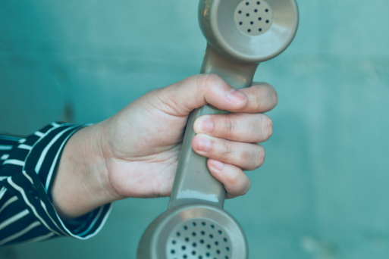
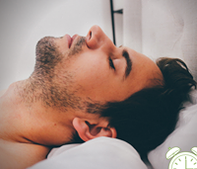
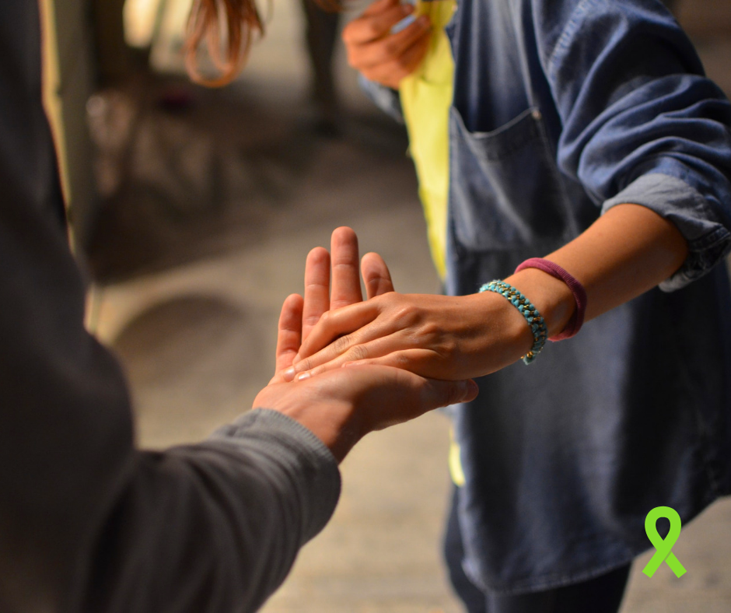
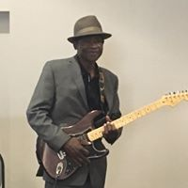
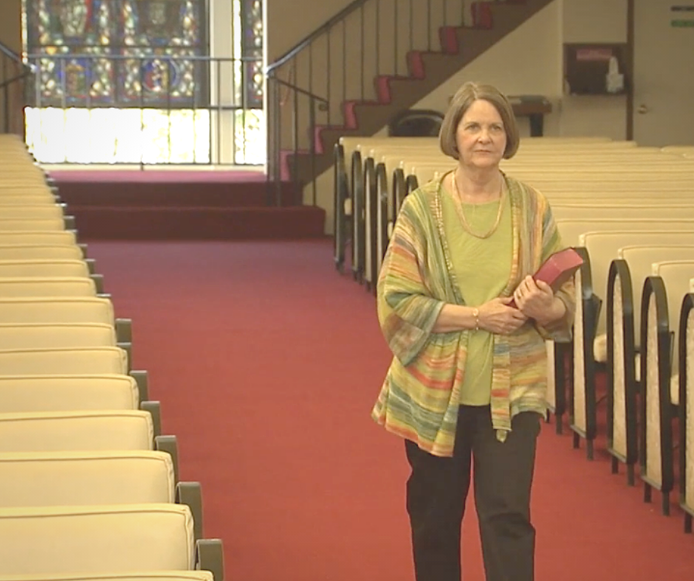
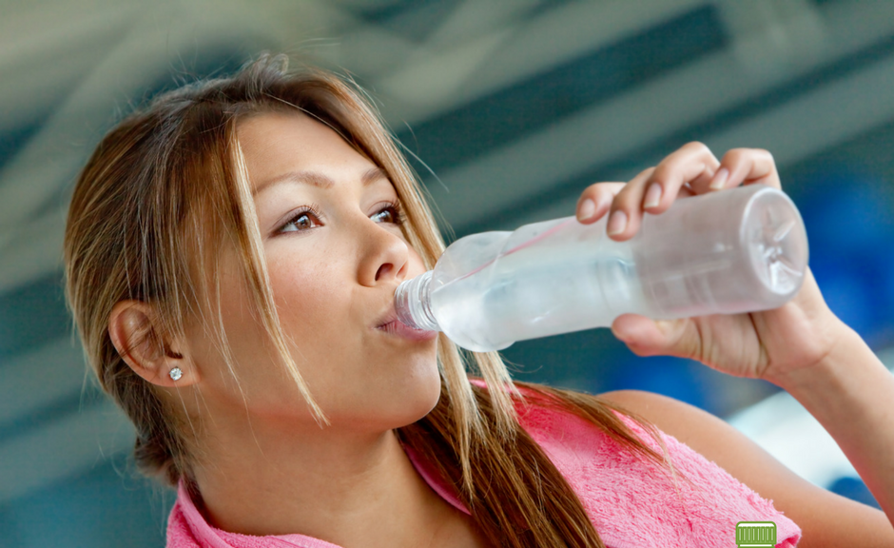
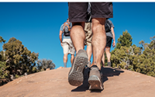
Build Your Self-Care Plan
Notes:
Lisa
The best way to practice self-care is to develop a self-care plan specifically designed and tailored just for you. Everyone will differ in what they need to feel re-charged and cared for. The important part is to include activities and practices that nourish whole health and that contain both maintenance and emergency care routines.
It sounds obvious, but for self-care to be effective, you have to actually do it. To increase the odds that you will actually implement your new self-care strategies try the following tips:
Happy people make healthy choices. Pick self-care strategies that seem fun, not things you think you “should” do. You’re more likely to do things that make you happy, and when you’re happy you’re more likely to things that make you healthy. It’s a virtuous cycle
Linking. Try adding your new habit to something that you already do routinely, like doing a 1 minute meditation after you brush your teeth, or taking a walk around the block after you get out of your car.
Make a safety net. There will be days when you just can’t. The important thing is not to keep doing all the things thereby making self-care another stressor, instead make yourself a list of nearly automatic things you can do to help yourself. In the resources, check out the free online tool you can use when you don’t feel able to make self-care choices for yourself. What matters is that you keep the habit of caring for yourself in some way as a regular practice.
Remember that self-care isn’t always adding something to your life, but subtracting something can be powerful too. Lessen your to-do list by letting go of an expectation of yourself or turn down an invitation that feels draining. Learning to say “no thanks” can be a powerful self-care tool.
For folks with mental health challenges or chronic health conditions that may benefit from a more comprehensive self-care planning approach, try Wellness Recovery Action Planning developed by Dr. Mary Ellen Copeland. Links to a free app for comprehensive wellness planning on your smart phone is available in the resources of this webinar.

Slide 12
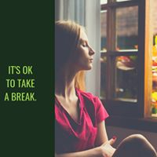
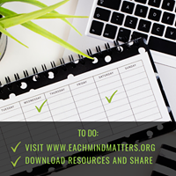
Sharing Self-Care Strategies With Others
Notes:
Aubrey
Raising awareness of the importance of self-care as a way of increasing resiliency, and offering concrete strategies to the communities we work with can be a great way to create mentally healthier people, families, and communities that can bounce back more readily from the stressors we have been facing.
First, practice implementing self-care strategies in your own life. Don’t underestimate the importance of modeling. This will also give you insights into how to make these a daily part of life that you can share with others and build your capacity to serve others effectively.

Slide 13
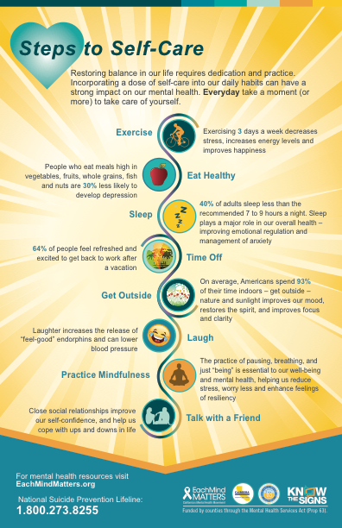
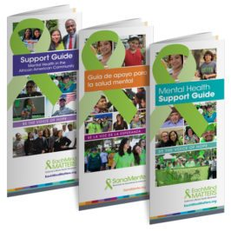
Self-Care Resources
Notes:
Aubrey
Next, we’ve created some easy-to-use tools to raise the topic of self-care in the communities you work and live within.
Start by sharing the Each Mind Matters Mental Health and Wellness Guide with the people you serve (which has also been trans-adapted for African American, Native American, Latinx, Chinese, and Russian communities).
When you’re ready to take self-care awareness to the next level, The Each Mind Matters Activation Kit includes a range of self-care tools that can be used to assess what we are doing, as individuals and within teams, to care for ourselves.
Use the drop-in article to share information in community and staff newsletters.
Share the Each Mind Matters Self-Care postcards
Share inspirational social media quotes with others.
Develop a Self-Care Plan. The UB School of Social Work’s Self Care site provides a Self-Care Starter Kit with valuable resources.

Slide 14
Self-Care Resources
Mental Health Support Guides from Each Mind Matters
Self-Care Resources from Each Mind Matters
Interactive Online Self-Care Guide
45 Simple Self-Care Practices from tinybuddha.com
Self-Care Starter Kit from the University of Buffalo School of Social Work
Wellness Recovery Action Plan Mobile App
Notes:
Aubrey
Develop a Self-Care Plan.
The UB School of Social Work’s Self Care site provides a Self-Care Starter Kit with valuable resources.
Taking the time and intentionally caring for our whole self – body, mind and soul – will keep us energized and mentally well. This is especially important for professionals in fields dedicated to helping and caring for others.

Slide 15
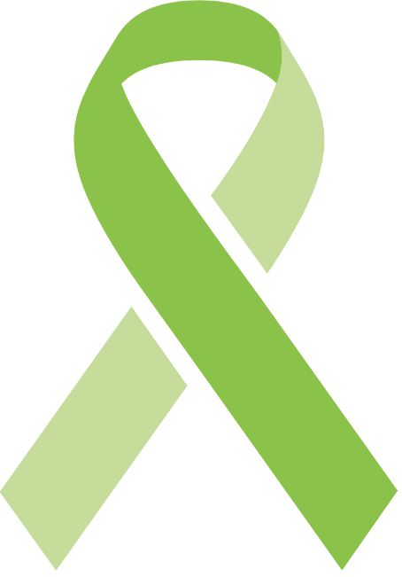
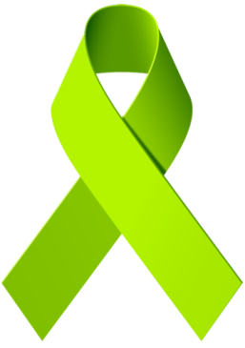
Q&A
15
Notes:
Aubrey

Slide 16
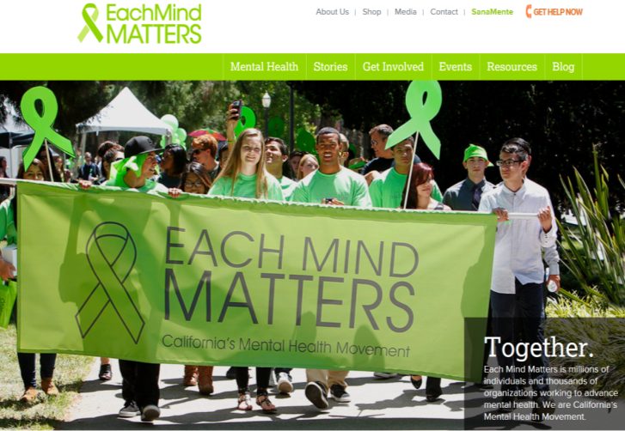
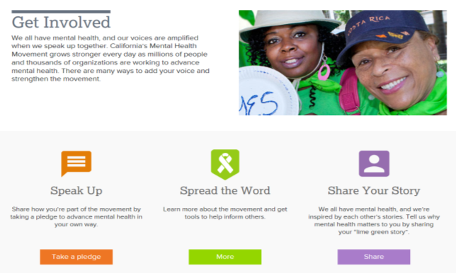
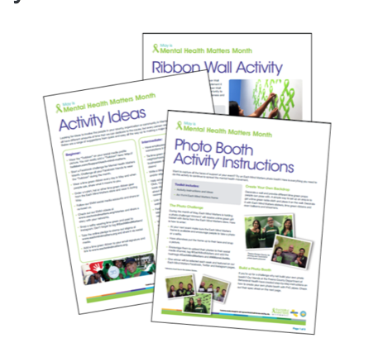
Join the Movement!
www.eachmindmatters.org/get-involved/spread-the-word/toolkit-may-mental-health-matters-month-2017/
16
Notes:
Aubrey-
There are many different ways to get involved in the movement. You can begin by browsing the website: eachmindmatters.org.

Slide 17
EMM Resource Center
https://emmresourcecenter.org/
Notes:
Aubrey
This website houses all the resources and materials that have been developed through the Each Mind Matters initiatives including SanaMente, Know The Signs, Directing Change, Walk In Our Shoes, Reconozca Las Señales, and Ponte En Mis Zapatos. It includes resources from data and reports to outreach materials, marketing materials, guides, toolkits, and more.
The Each Mind Matters Resource Center is designed to make it easy to find what you need. Utilizing the search box you can simply type in what you are looking for using a keyword like the subject or language. If you click on the Advanced Search button, you’ll see a list of options you can select to search for including Resource Type, Target Audience, Language, Initiative, or Topic.
If you prefer to browse through the resources, you can click on Initiatives or Collections at the top of the page. Initiatives will show each of our different programs and all the resources developed through that program. Collections shows different groups of resources organized by Events/Observations and Target Populations, for example a collection of resources for Older Adultsor for Employers and Workplace Issues.
All the resources and materials shared through the Each Mind Matters Resource Center are available free for you to download and use for the purposes of mental health stigma reduction, mental health promotion, and suicide prevention in the state of California.

Slide 18
Sign Up for Our Newsletters!
Each Mind Matters Newsletter
The Each Mind Matters Newsletter is a monthly newsletter created for anyone interested in supporting
the mental health movement in California. Each edition includes a recap of the top headlines in
mental health and a wealth of resources to help spread the word about mental health.
Subscribe here: http://www.eachmindmatters.org/get-involved/subscribe/
Insider Newsletter
The Each Mind Matters Insider Newsletter is a monthly newsletter created specifically for service providers.
It includes information about relevant resources, upcoming events, and opportunities for providers to get
involved in California's Mental Health Movement.
Subscribe here: http://emmresourcecenter.org/subscribe-newsletter
Notes:
Aubrey –
Keep up to date with Each Mind Matters announcements, new resources, and opportunities through our newsletters. The Each Mind Matters newsletter targets general audiences with information on the mental health movement in California and across the county. This one is great for any clients or program participants who want to be more involved in the larger efforts.
The Insider newsletter is for providers and professionals who do work related to mental health and suicide prevention. It highlights tools and resources, upcoming events, and opportunities to get more involved in the statewide movement.
Please note that these newsletters are in English.

Slide 19
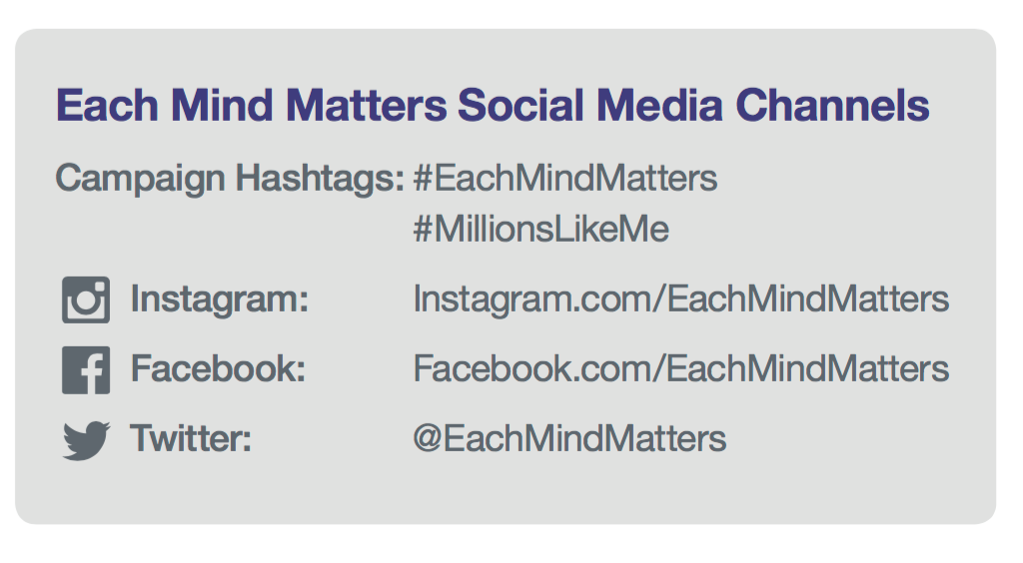
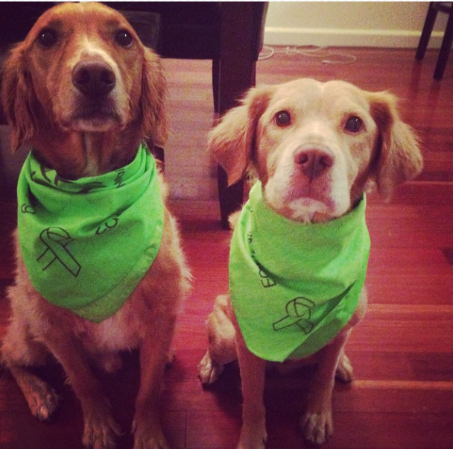
Stay connected
Stay Connected on Social Media
#EachMindMatters
#SanaMente
Notes:
Aubrey
Stay connected with us on social media too. We do no have separate social media accounts for SanaMente, but include SanaMente and posts in Spanish on the Each Mind Matters channels.

Slide 20
Q&A
20

Slide 21
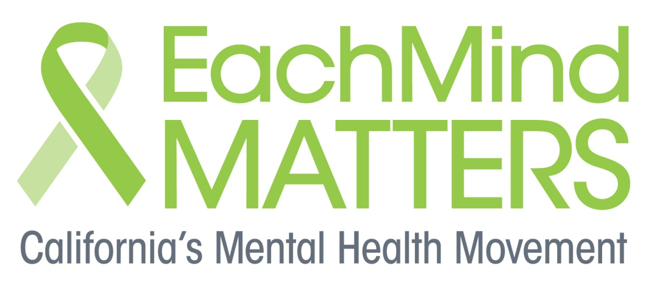
Thank you!
21
Notes:
Aubrey

