Slide 1
MY3 Suicide Prevention Mobile App

Slide 2
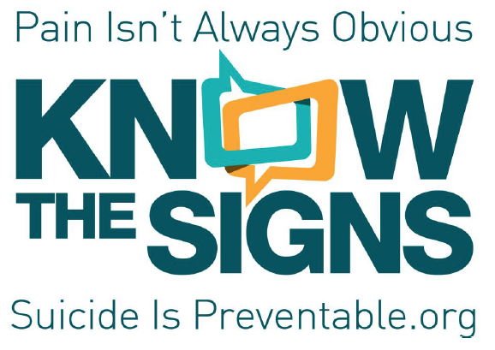
Partners

Slide 3
Quick stats
Launched in California in November 2013
Total # of downloads since launch: 1000+ (primarily in California)
Transitioned to the National Suicide Prevention Lifeline in Summer 2014 for national dissemination
Notes:
We stopped counting downloads when we transitioned to Lifeline

Slide 4
Know the Signs Campaign + MY3
Goals of Know the Signs
Helpers become more aware of warning signs for suicide, how to talk about suicide and how to help
Individuals who are at risk for suicide are helped by others and are aware of supportive resources
Notes:
App is meant to connect helpers to the at-risk and decrease the thought process that is required when someone wants to reach out to someone else for help.

Slide 5
MY3 Basics
Goal: Connect individuals who are at-risk for suicide or experiencing thoughts of suicide to their support network
Cost: Free
Highly customizable
Where to download: App Store & Google Play
Languages: English & Spanish
Using Audience: All individuals who are at risk for suicide
Promoting Audience: Mental health care providers, crisis counselors, survivor support groups etc… anyone who can identify individuals who may be at risk for suicide
Notes:
Audience: We made MY3 to be especially easy-to-access, especially for individuals who are may not be as familiar w/ mobile app interfaces. We made the features very easy-to-use, straightforward, and we provided clear steps to follow.

Slide 6
App must-haves: from the suicide attempt survivor perspective
App needs to be uncluttered and easy-to use
Getting connected to support networks as quickly as possible should be easily accessible
Notes:
Individuals who had attempted suicide or had felt suicidal contributed to the creation of the app. These were the “must haves” that the Santa Clara Suicide Intervention Workgroup said had to be in the app.

Slide 7
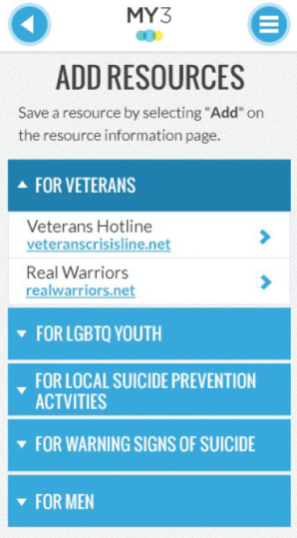
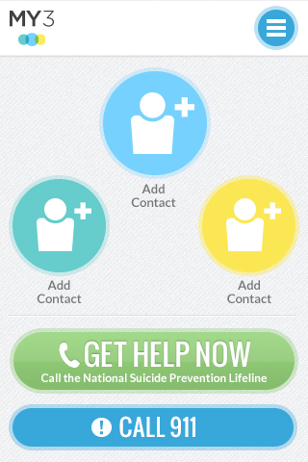
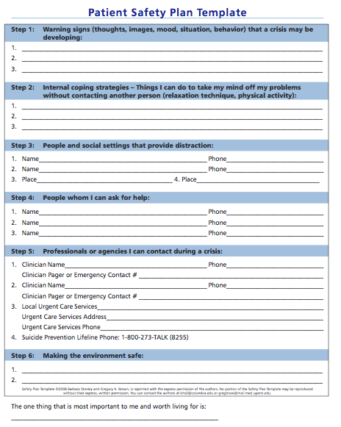
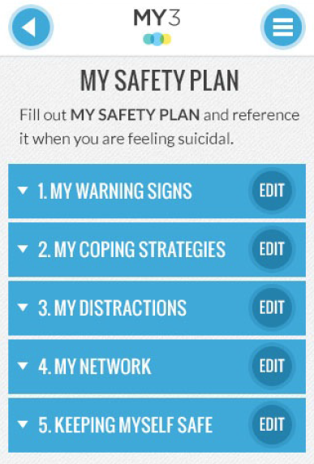
Safety planning a new way!
Notes:
Safety planning is regularly done on paper. Patient Safety Plan Template follows the Barbara Stanley and Gregory Brown model. Downsides to paper safety planning – individuals not carrying their safety plan with them at all times, difficulty in committing the safety plan to memory, multiple versions of a safety plan created over long periods of time, losing the paper, etc.
MY3 app brings all the components of safety planning together in an easy-to-carry, mobile application.

Slide 8
Mobile Application www.MY3app.org
Target audience: Those at risk for suicide
Purpose: Getting those at risk for suicide connected to their primary support network when they are in crisis; also provides safety planning and other helpful resources
Notes:
After several months of community input and app development, this was the result. (note that if you search in the app store, hunt for ‘MY3 safety plan’, as there are several apps called MY3)

Slide 9
Notes:
Play video with speakers on or hold microphone next to computer speaker
After video, will showcase various features of the app

Slide 10
MY3 Features: Homepage
Main page
Add 3 primary contacts
Pre-loaded with buttons to call National Suicide Prevention Lifeline and 911
Notes:
this opens up everytime someone opens the app. This is the primary feature that makes the app unique –
People encouraged to include a local crisis hotline and are encouraged to tell these contacts that they have been added to MY3 and may be contacted if they start feeling suicidal
911 in case they have already harmed themselves
It’s quite possible that simply seeing these individuals on the homepage will demonstarte to the individual that there is a support network and that there are people to call on – decreasing suicidality

Slide 11
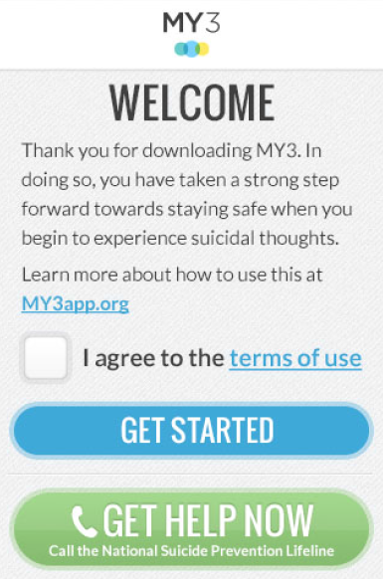
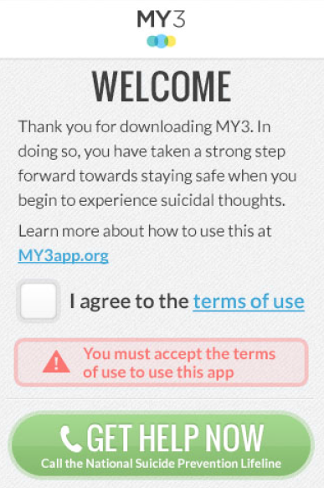

Slide 12
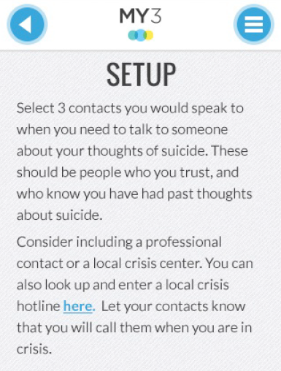
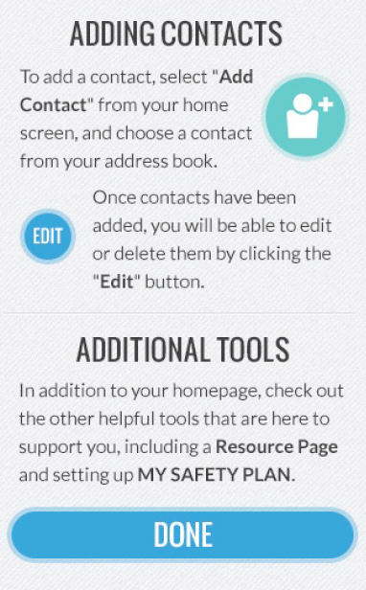

Slide 13
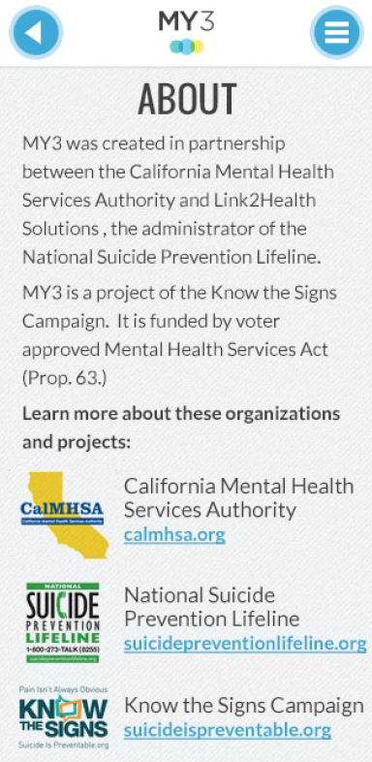
Notes:
Can hide this slide if you choose

Slide 14
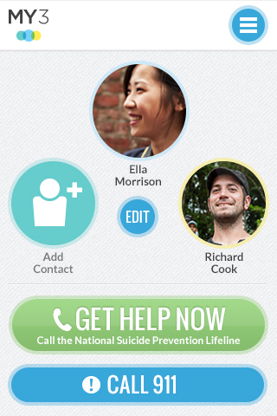

Slide 15
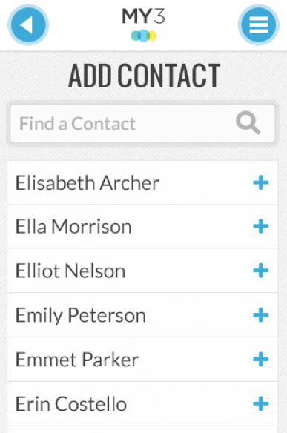
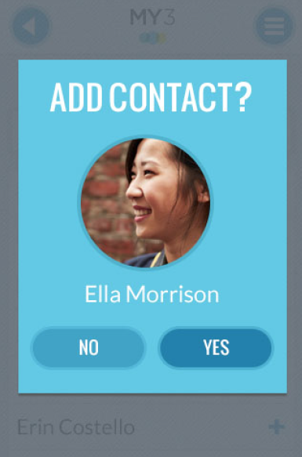

Slide 16
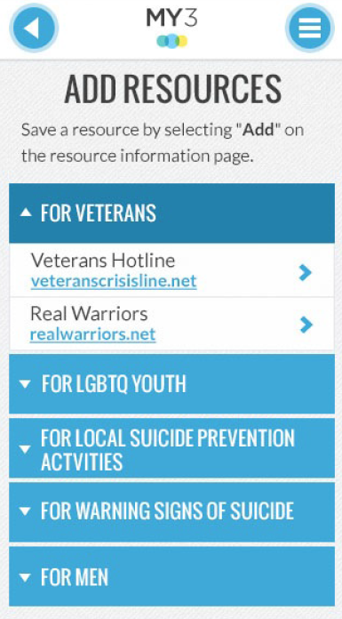
MY3 Features: Resources
Resources that the individual can choose depending on their needs
Can be edited depending on individual needs
Notes:
Categories:
15 resources that provide helpful information
Veterans; LGBTQ Youth; Local SP Activities; warning signs; youth; mental health; suicide loss survivors; suicide attempt survivors; men
Additional resources cannot be added.

Slide 17
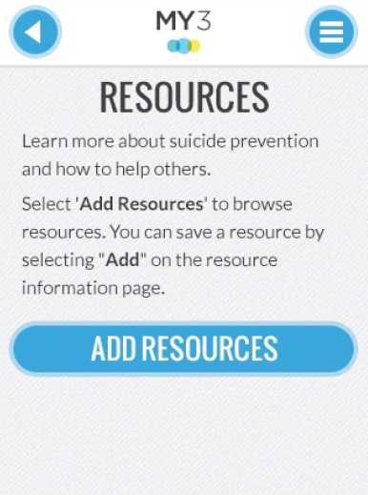
Notes:
Point out the resources for specific populations—veterans, LGBTQ youth, men—and how to localize informaiton

Slide 18
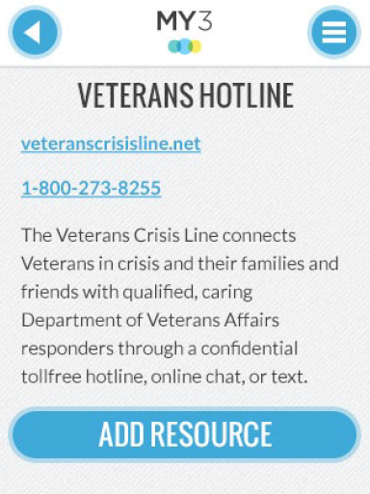

Slide 19
MY3 Features: Safety Plan
Follows Safety Plan by Barbara Stanley & Gregory Brown (2008)
A tiered plan that provides activities for distraction, and people to call on depending on degree of suicidality
A tool in your therapeutic relationship; a plan to stay safe for the individual
Can be emailed
Notes:
Why develop safety planning as an app?
It is with you when you need it most
Easily accessible for update and review
Quick access to resources
Direct dial for emergency assistance
Can be emailed to a provider (or others)
Crisis hotlines can use it by:
Eliciting resources and support sources from the caller
Encourage the caller to continue to develop the plan with their treating clinician
Can complete the plan before ending contact with an at risk caller
For review in follow-up calls

Slide 20
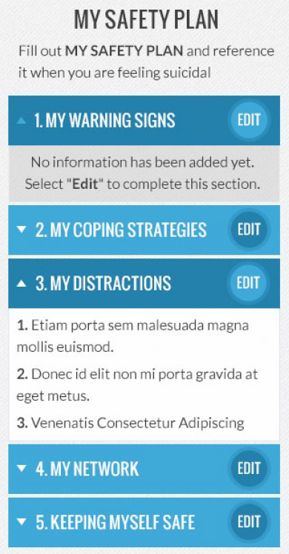

Slide 21
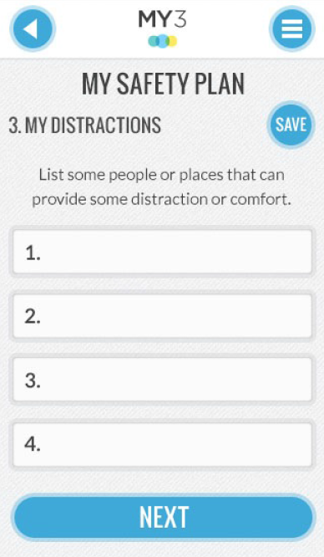

Slide 22
MY3 dissemination in California
Via California county health agencies, local organizations, and crisis centers at the following locations:
Gatekeeper trainings
Health fairs
Suicide prevention presentations to healthcare and mental health care providers
Suicide Prevention Task Force meetings
Schools and school counselors
And more!
Notes:
Also bought ads and sent press releases to health care providers throughout the state

Slide 23
Praise for MY3…
“As someone who has been in the field of suicide prevention for over 10 years, I have found MY3 to be tremendously helpful. It is so easy to use and accessible, it has made my job of helping people at risk of suicide easier. Clients love the discreet design of the app. They can have it on their phone and not worry they will be “found out”. It gives them a feeling of confidence and control. No longer do they have to hide a piece of paper that says “Suicide” on it, they can download MY3 and have a usable tool to access whenever they need help.”

Slide 24
Visit www.MY3App.org
Notes:
Share about MY3 via My3app.org. Visit the “Get Involved” page to download and print My3 materials to share with clients (fliers, wallet cards). Handout copies if you have them.

Slide 25
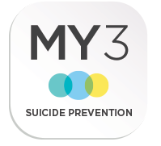
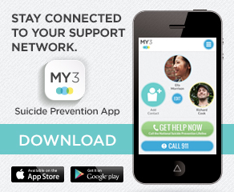
MY3 Widgets – add them to your site!
Notes:
Widgets are also available on the MY3 app website and we encourage suicide prevention organizations to place these widgets on their website. People who click the widget will be directed to the MY3 website.

